Slide 1
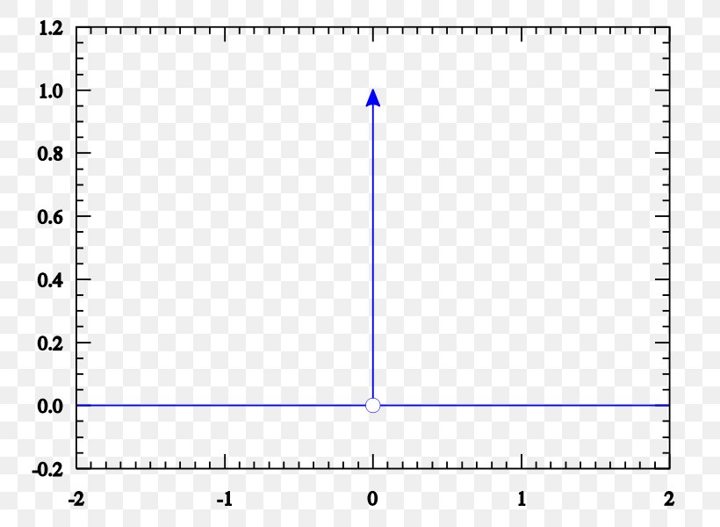
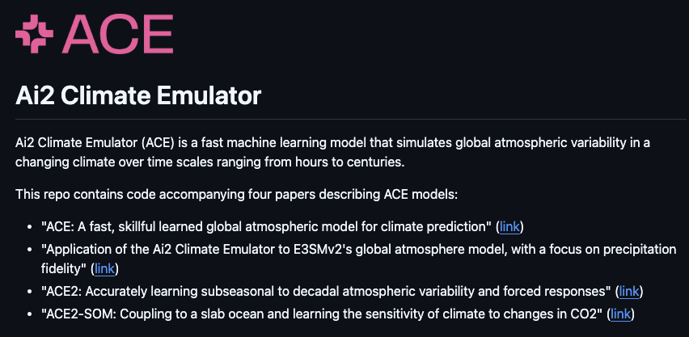
Reanalysis-based Global Radiative Response to Sea
Surface Temperature Patterns:
Evaluating the Ai2 Climate Emulator
Zihui(Andy) Liu

Slide 2

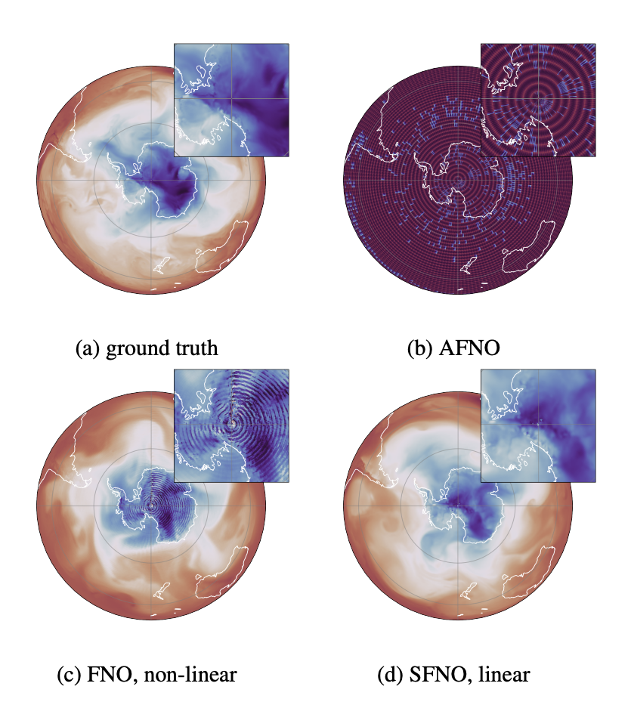
Overview
ACE
3 versions
SFNO
Green’s Function Experiment
Response on perturbations
Well, let’s guess everything is linear
GFMIP setups
Emulator testing framework
Function

Slide 3
Motivation (Section 1.1)
Understanding Climate Feedback → GCMs
But…… Lots of parametrizations
And…… Slow
So…… Machine learning → Emulators!!
Emmm…… Are they good?
¯\_(ツ)_/¯… I don’t know…… but they are definitely fast…
………… …
Emmmmmm… I mean, they parametrized EVERYTHING. What do you expect…
(╯°□°)╯︵ ┻━┻
What if we want to analyze climate emulators like GCMs?
Green’s Function Experiment
Before that, Let’s quickly cover the ML basics →

Slide 4
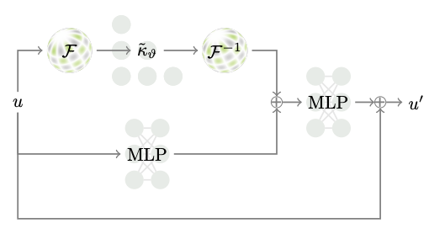
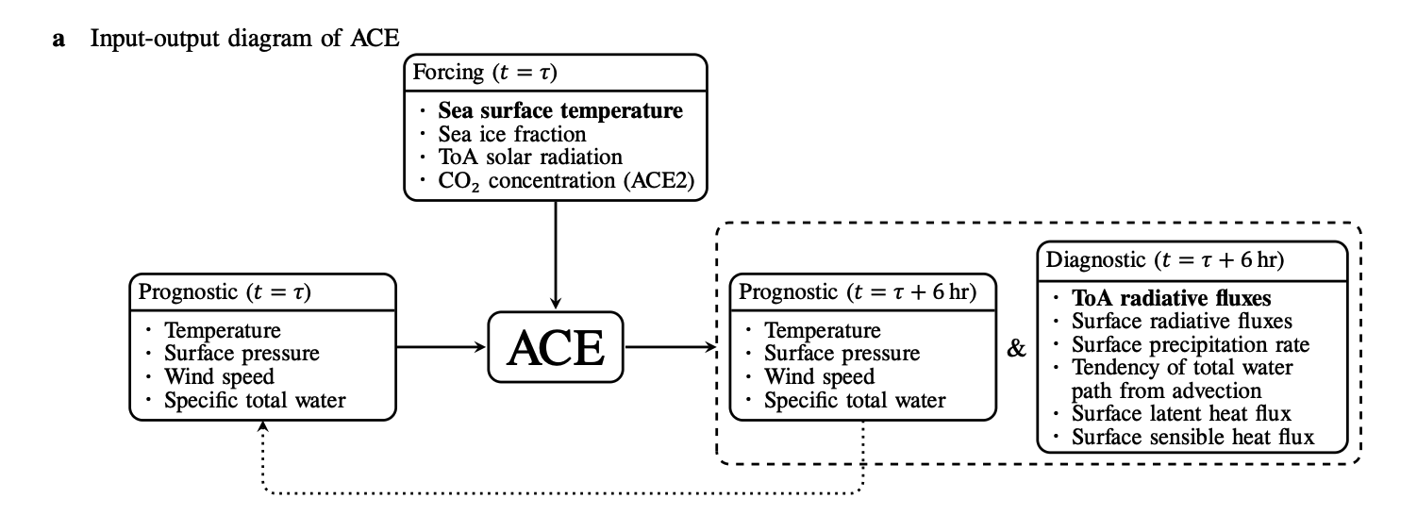
AI2 Climate Emulator (ACE) (Section 2.1)
SFNO
Based on Spherical Fourier Neural Operators
(Bonev et al., 2023; Yik 2025, UW Atmos MLJC)
Autoregressive
input T, output T+6hr
3 Versions
ACE-VF3 ← GFS
ACE-EAM ← E3SM
ACE2-ERA5 ←ERA5
Also forced by CO2
Figure 2 from Bonev et al., 2023
Foreshadowing
Figure 1a

Slide 5
Thank you.
That’s all I am going to say about Machine Learning in this meeting.
Thanks for listening, and enjoy your pizza…
（ ^_^）o自自o（^_^ ）
Now, back to Green’s function→

Slide 6

Green’s Function (Section 1.2)
How the dynamical systems behave under point-perturbation
Idealized situation
Response to local perturbation
Note: No time-dependence. We are more interested in long-term response, i.e. the new equilibrium. We don’t need the transient response.
Perturbation is like a constant source, and the sink is the ambient whatever
Representing the causal response
Because we literally poke the system, observe its response, and compare against control.
-log(
1
1
)
0*

Slide 7
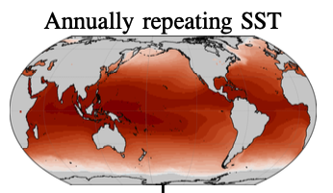
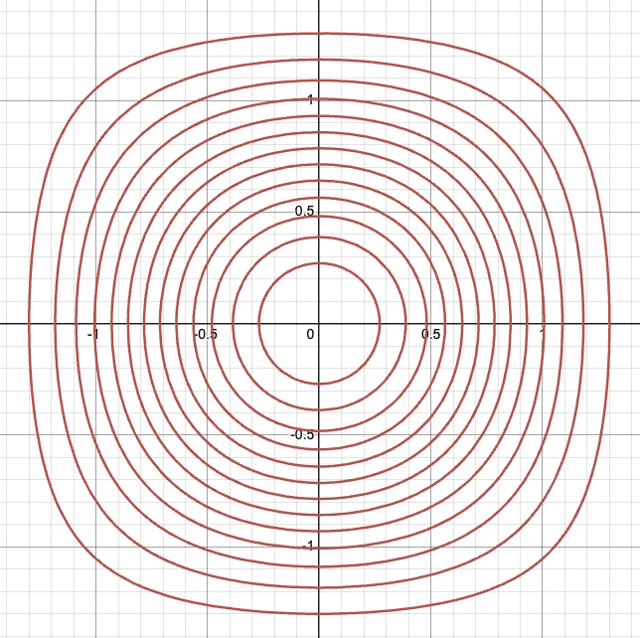
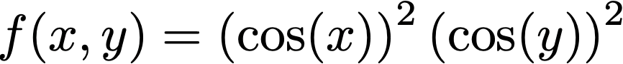
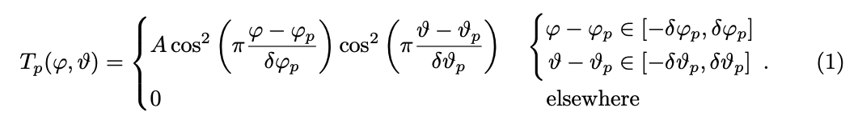
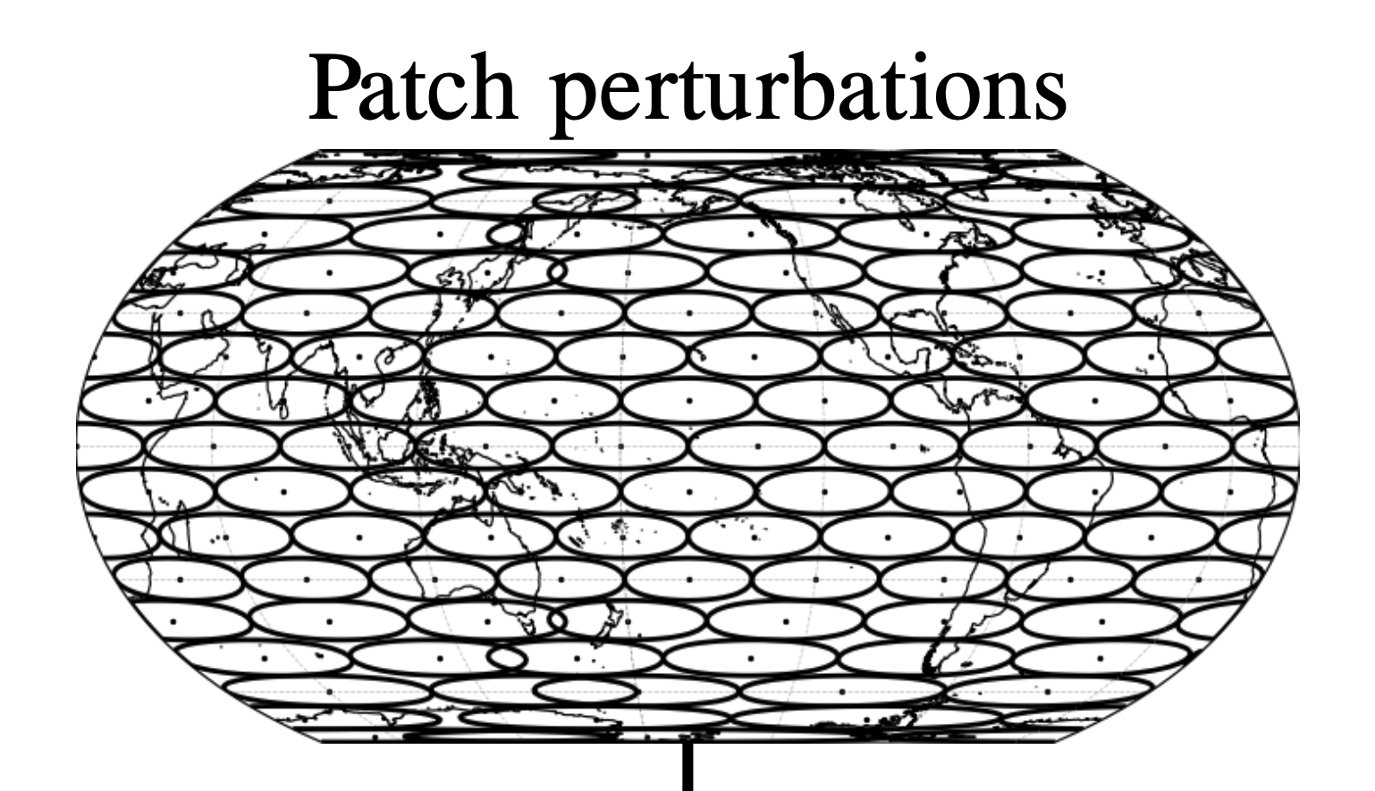
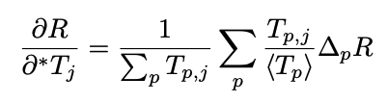
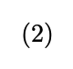
Green’s Function Experiment (Section 2.2)
Main Quest: (Finish all side quests to unlock this one)
🔒 Find the TOA response R given local perturbation in SST
Side Quest:
Control Run, 20 years
Apply the SST perturbation
Run the new system for 2 + 10 year
REPEAT 3 for each patch
Calculate feedback using this equation
HAHA, Repeat 1-5 for each ACE
ACE-VF3 ACE-EAM ACE2-ERA5
* Please don’t ask me any questions about this equation. It broke me

Slide 8
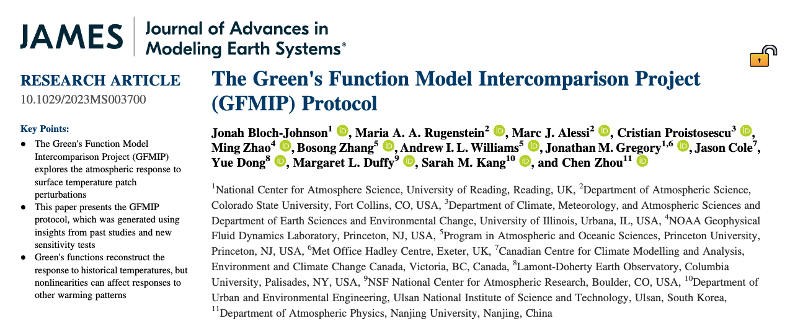
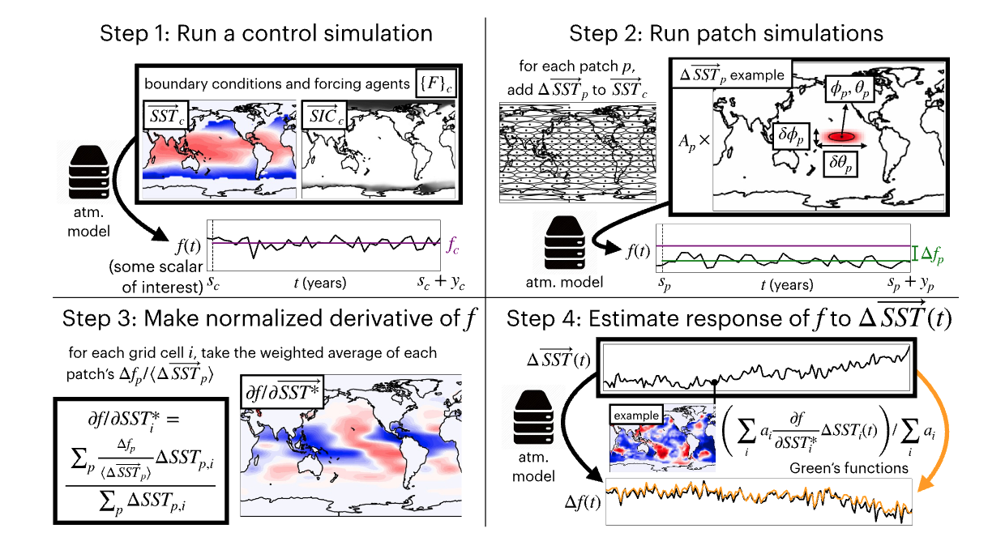
Green’s Function Experiment
Previous procedure is from
Green’s Function Model Intercomparison Project (GFMIP; Bloch-Johnson et al. 2023)
Protocol for GCMs
How models response to pattern effect.
GCM doesn’t respond consistently
No “Ground Truth”
Figure 2 from B-J et al. 2023

Slide 9
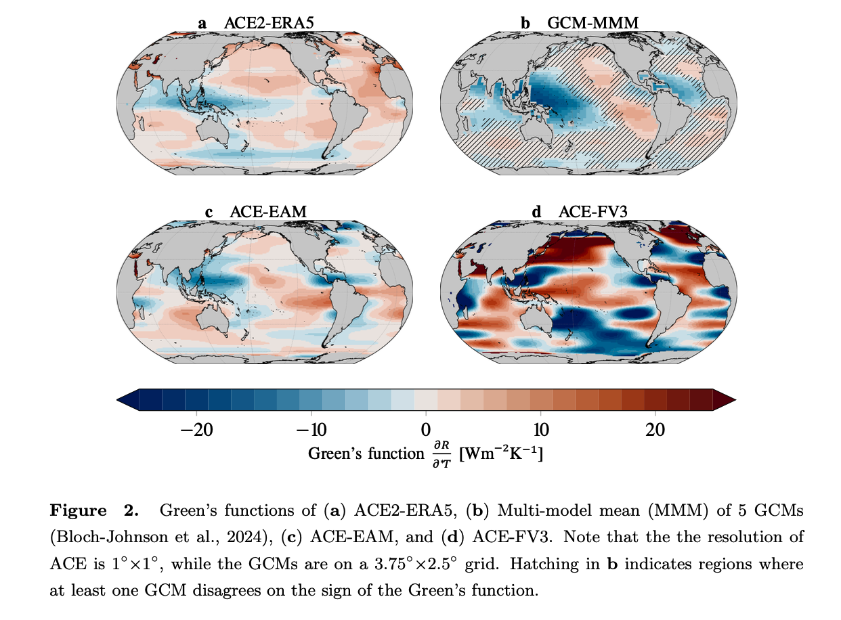
Green’s Function Experiment (Section 3.1)
Control
ACE2-ERA5
Reproduce some features
Amplitude is low
ACE-EAM
Good!
ACE-FV3
Bad
(possible reason) Numerical Weather Prediction model is not energetically closed

Slide 10
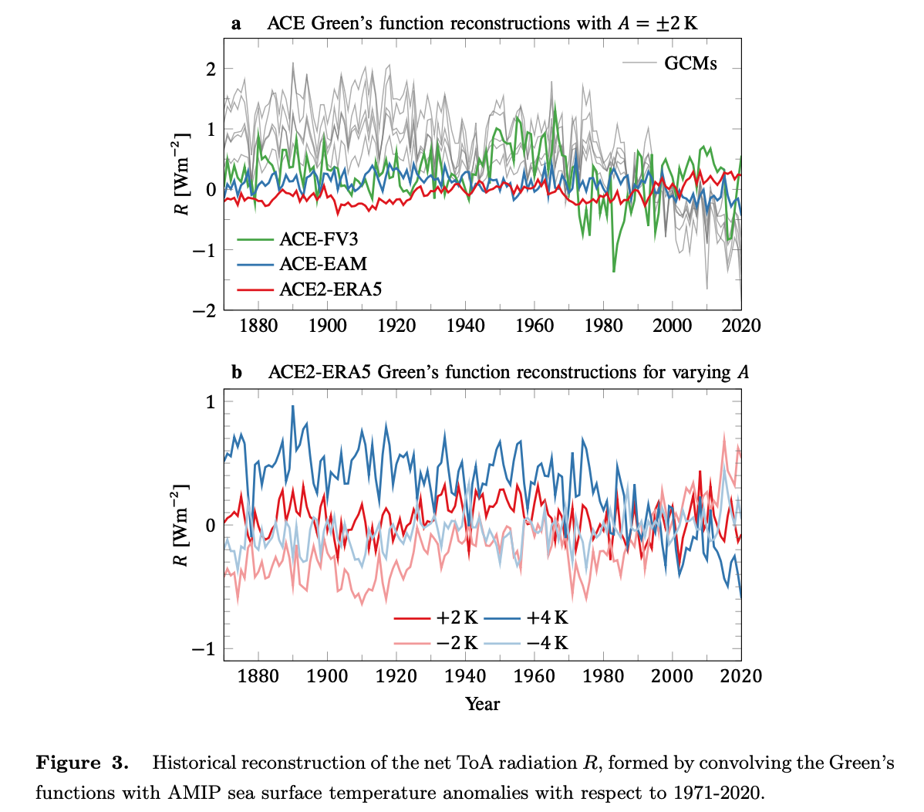
Green’s Function Experiment (Section 3.2)
Historical Reconstruction using ACE Green’s Function
The reconstruction is not linear.

Slide 11
Discussion (Section 4)
[Potential Problem] Observation is to short to see response. We have to rely on GCMs currently.
ACE2-ERA5 have fixed CO2 during the Green’s function experiment.
[Problem] ACE2-ERA5 biased toward the observation, and have hard time extrapolate prediction
[Potential Fix] physical constrain the ACE2 model
[Benefit] Investigate nonlinear feedback using emulator.
Emulator is doing poorly in green’s function experiment.
Turn the bug into feature: green’s function experiment is a good benchmark for emulator!

